Slide 1

IEEE Entrepreneurship Explained
photographer
unknown
Ken Stauffer–2020 Chair, IEEE Entrepreneurship

Slide 2

IEEE Entrepreneurship
Who we are?
What we do?
How you can join us?

Slide 3
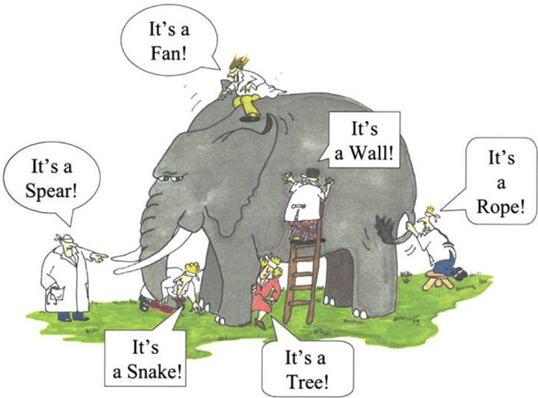
Many opinions about who we are …..
“And so these men of Indostan
Disputed loud and long,
Each in his own opinion
Exceeding stiff and strong,
Though each was partly in the right,
And all were in the wrong!”
–John Godfrey Saxe
The Blind Men and the Elephant

Slide 4
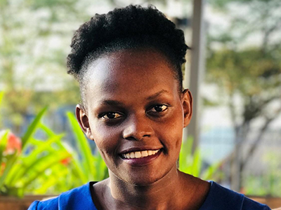
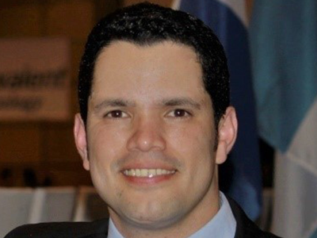
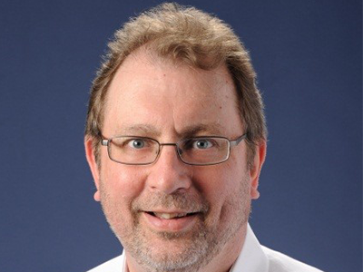
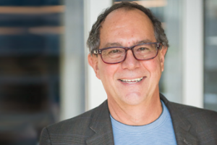
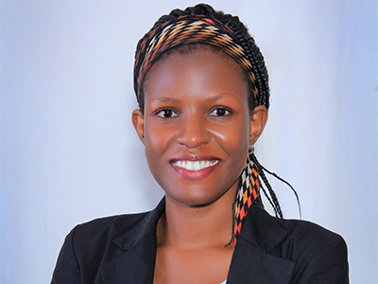

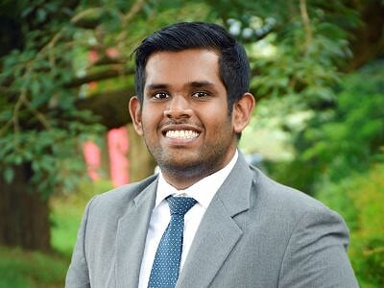
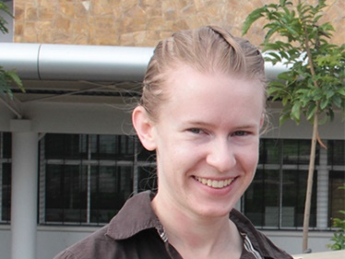
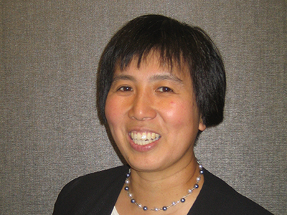
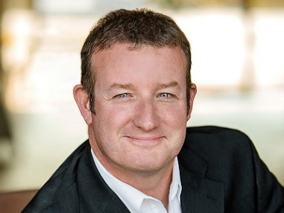
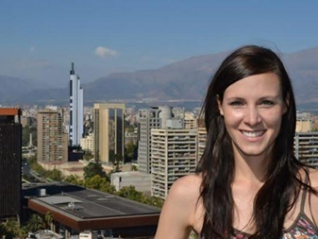

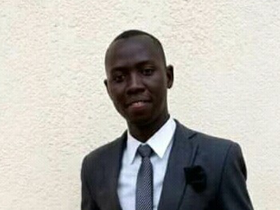

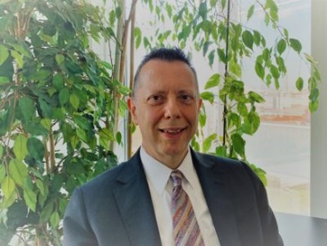
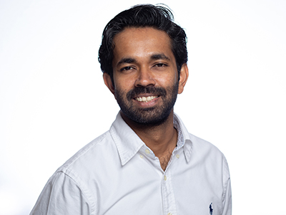
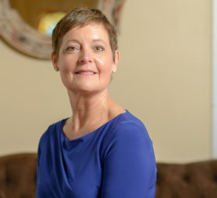
Our 2020 IEEE Entrepreneurship Steering Committee
No particular order.
Decoder key is at:

Slide 5


IEEE Entrepreneurship
Our Mission:
“to foster entrepreneurial engineering
and technological innovation
for the benefit of humanity”

Slide 6

Technology for the Benefit of Humanity
“Where IEEE Entrepreneurship and Humanitarian Activities Meet ”

Slide 7

IEEE Entrepreneurship
Our Goals:
Be relevant to engineering driven entrepreneurs in our IEEE Entrepreneurship ecosystem
Explore and better understand our vast entrepreneurial ecosystem’s needs
Create useful product/services that provide value and create revenue streams

Slide 8
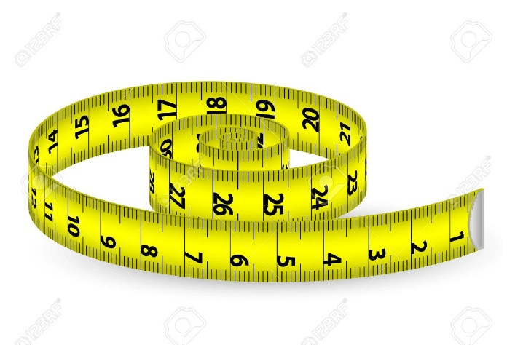
IEEE Entrepreneurship
Measurements – 360° view:
Customer Value Added (CVA) Did we create value for our customers?
Economic Value Added (EVA) Did we create economic value for our organization?
Personnel Value Added (PVA) Did we develop leadership for the future?
“Leadership is not about the next election,
it is about the next generation.”
–Simon Sinek

Slide 9


Our IEEE Entrepreneurial Ecosystem
Those who are IEEE members and are interested in entrepreneurship
Some in our ecosystem who become IEEE members because they see value.
Some who are not IEEE members, but want to be a part of our entrepreneurship community.
IEEE Members
IEEE Entrepreneurship
Ecosystem

Slide 10

IEEE Entrepreneurship
What we are not:
An IEEE Society, Council, Affinity Group or
Technical Community ….
Academia or Industry -- in the first order
What we are:
A entrepreneurial community inside and outside IEEE with approximately 17,000 virtual members
Rebellious – see Apple Super Bowl ad in 1984 https://www.youtube.com/watch?v=2zfqw8nhUwA

Slide 11
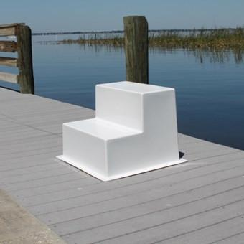
Market Research –Step 1
IEEE Entrepreneurship conducted market research in Q1 2020
  about 4,000 people in our IEEE Entrepreneurship ecosystem were randomly sampled
  502 people responded for, a response rate of 13%
Our goals were to:
  characterize our IEEE Entrepreneurship demographics
  understand the value of products that we could develop

Slide 12
Demographics of our IEEE Entrepreneurship Ecosystem
Academic research start-ups (23%)
Aspiring entrepreneurs – product (22%) ideation stage
Start-up entrepreneurs (26%)
Growth and scaling entrepreneurs (12%)
Investors (7%)
  Accelerators
  Crowd Funding
  Pitch Competitions
  Angels
  VCs
  Governments
Academic research
start-ups
Aspiring entrepreneurs
Start-up entrepreneurs
Scaling or Growth entrepreneurs
IEEE
Members (73%)

Slide 13
IEEE Entrepreneurship Questionnaire – Key Findings
• Almost half (46%) of respondents described their startup model as both products and services. The other half were split between services (38%) and products (17%)
• Six in ten (59%) respondents have additional paid professional positions other than their entrepreneurial work. About 30% spend 30 - 60+ hours/ week in their business
• Respondents have been active for an average of 9 years as an entrepreneur
• Six in ten (60%) respondents feel their startup or entrepreneurial idea aims towards at least 1 United Nation Sustainable Development Goal, with the highest representation (60%) in Goal 9 -- Industry, Innovation and Infrastructure

Slide 14
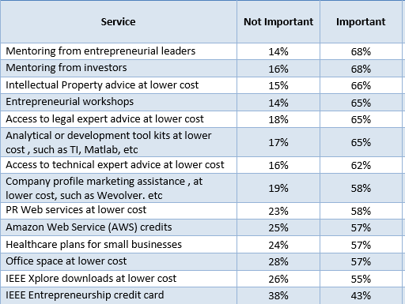
IEEE Entrepreneurship Products/Services That Could Provide Value

Slide 15

“Powered by IEEE”– Imagine the Possibilities
  Goals
    Create value for entrepreneurs / start-ups so their websites display the “Powered by IEEE logo” -- eyeballs and membership
    Create revenue streams for IEEE -- money
  Criteria
    Start-ups with less than 25 people and 9 years of existence
    Company C-level executive is an IEEE Member (CEO, CTO, CMO, CFO, MD, etc.)
    At 10+ years or 50 employees certain perks / pricing change, but "Powered by IEEE" logo can remain on website
  Some 2020 -2021 Products
    Mentoring ILN course discount
    Freshworks / AWS credits Priority registration, IEEE Entrepreneurship events
    Xplore discounts Start- Up Marketing Assistance

Slide 16

In the works --- “IEEE Entrepreneurship Impact Award”
  Designed to be awarded annually to an individual who made a significant impact in our IEEE Entrepreneurship Ecosystem
  Judged by a Special Awards Committee of 3 people
  Criteria include -- Entrepreneurial Spirit, Value Creation, Impact (deep or wide), and Sustainability
  $2,000 cash award plus a plaque
  Presented in person at an IEEE Entrepreneurship event

Slide 17

IEEE Entrepreneurship
What we do

Slide 18














Sample of IEEE Entrepreneurship Events
Both IEEE and Non-IEEE Events
  Speakers
  Panels
  Exhibits
  Judging Pitch Competitions
  “IEEE Entrepreneurship Stars”

Slide 19



Video Pitch Challenge at G-STIC 2019
Partnership between HAC, IEEE Entrepreneurship, and the
UN Major Group on Children and Youth (UN-MGCY)
Video Pitch Competition based on the UN SDGs for G-STIC 2019
and on IEEE’s mission “Technology for the Benefit of Humanity”
  Energy, Oceans, Food, Health, Circular Economy, Education,
  Water, CO2 as a Resource, Housing, Climate Action
Judged by Samantha Snabes, Janati Nakimera, and Nadim Choucair using IEEE Entrepreneurship’s criteria of “Innovation, Product, Market, Diverse Team, Traction
72 videos from 24 countries
Video pitch winners in three categories
  Product Ideation
  Start-Up
  Growth

Slide 20
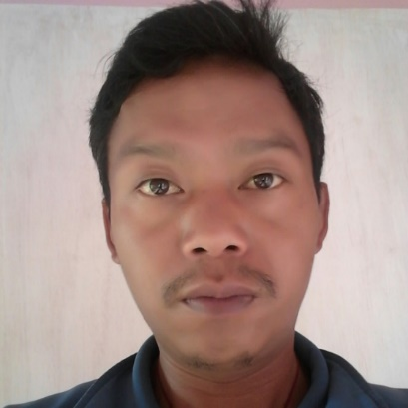
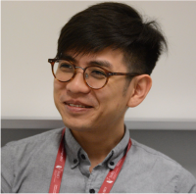
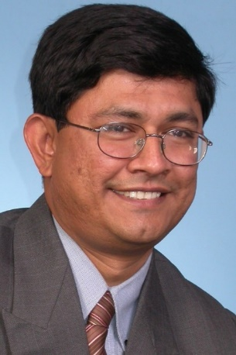
Introducing the 2019 Winners
Passang Wangdi
from Bhutan
Rex Tan
from Singapore
Venkat Rajaraman
from India
Greenovation Bhutan builds decent housing for communities using recycled plastics as an alternative construction foundation
AEvice Health has developed a smart medical device that can predict the onset of an asthma attack
Cygni developed a community-level, smart solar grid–
a sustainable solution to provide electricity in rural communities.

Slide 21
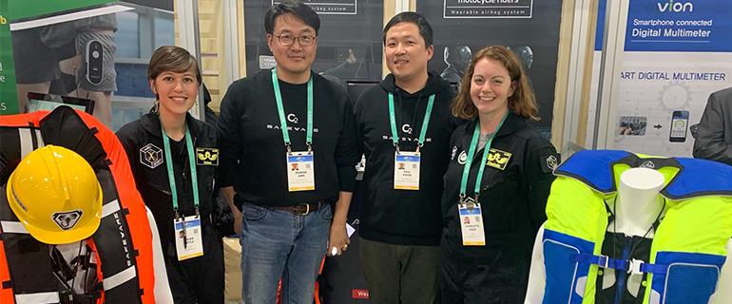
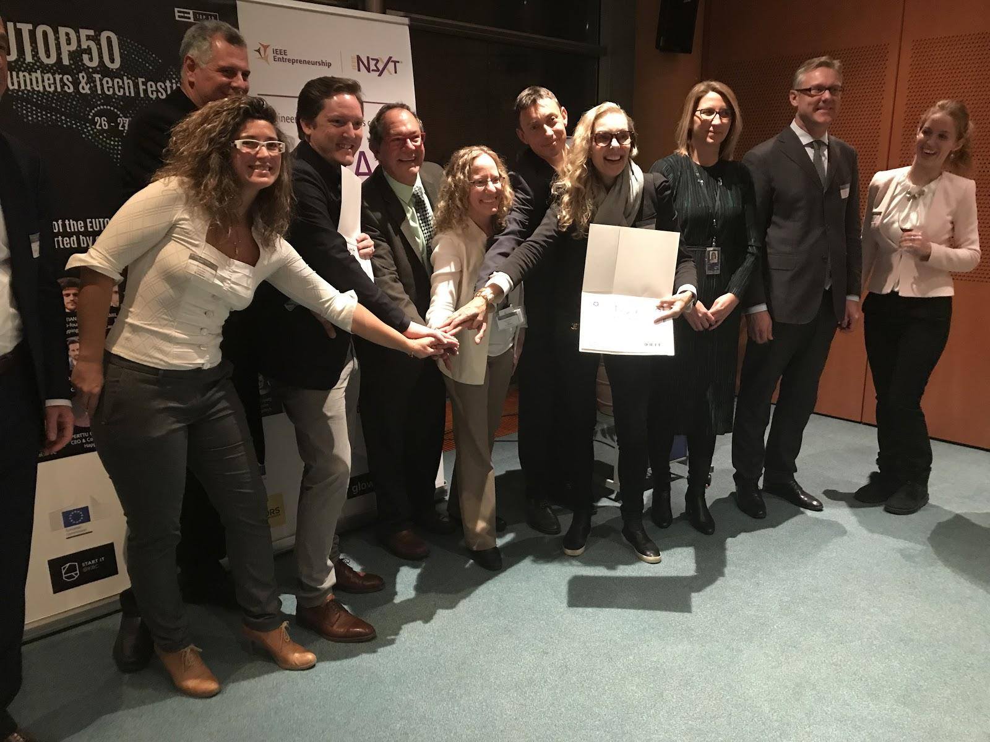
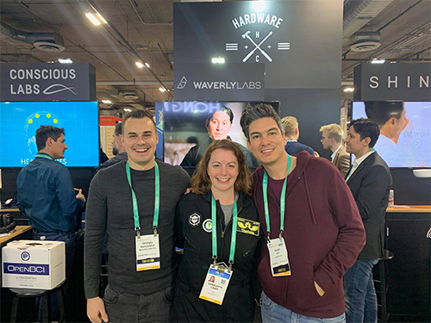
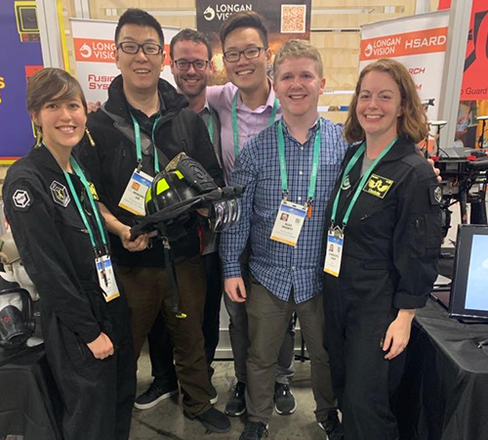
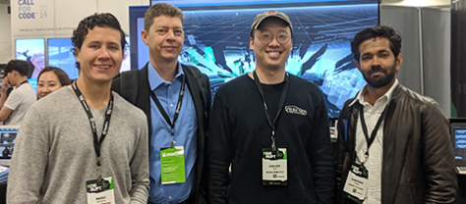
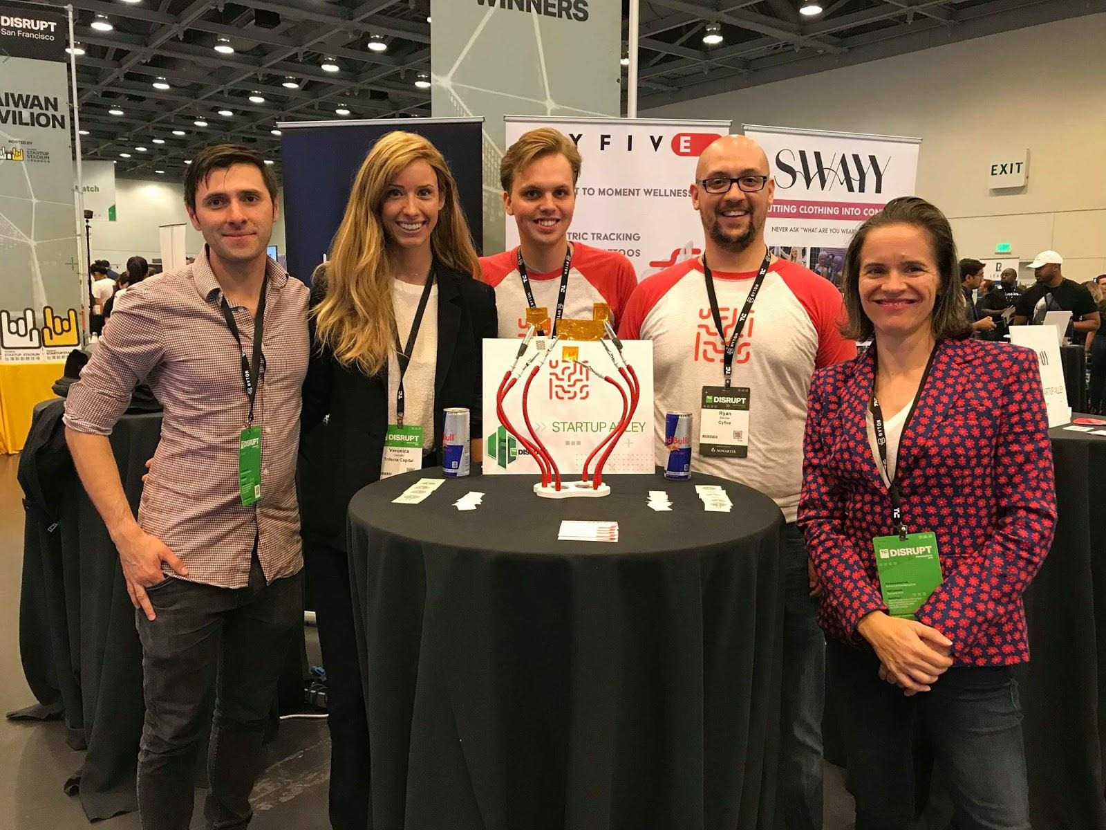
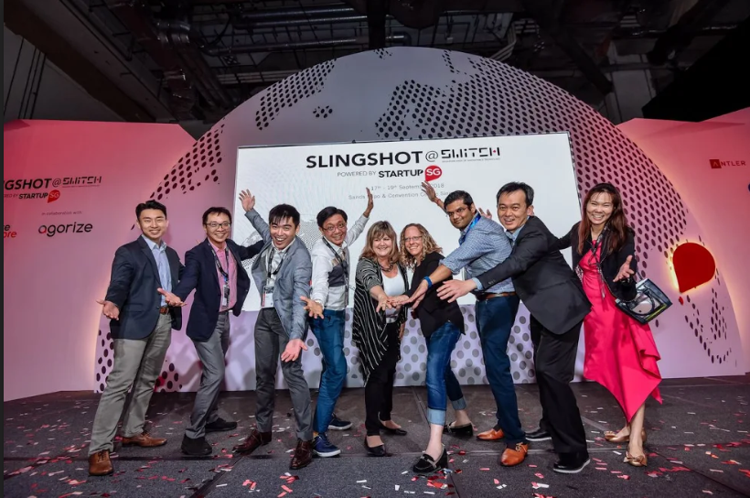
IEEE Entrepreneurship Stars
2020 CES
in Las Vegas
Top 3 of the top 20
European Companies
at K4I in the European
Parliament
Slingshot in Singapore
TechCrunch in California

Slide 22
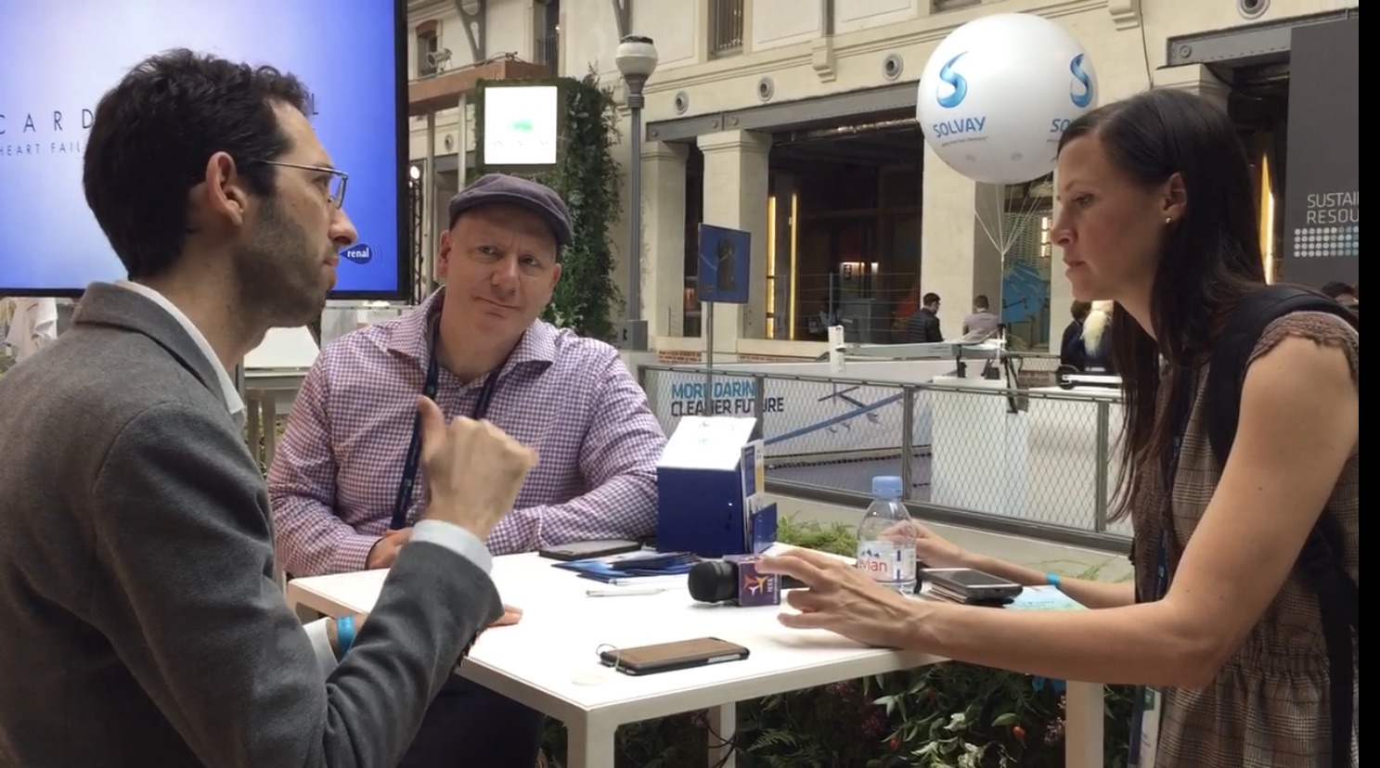
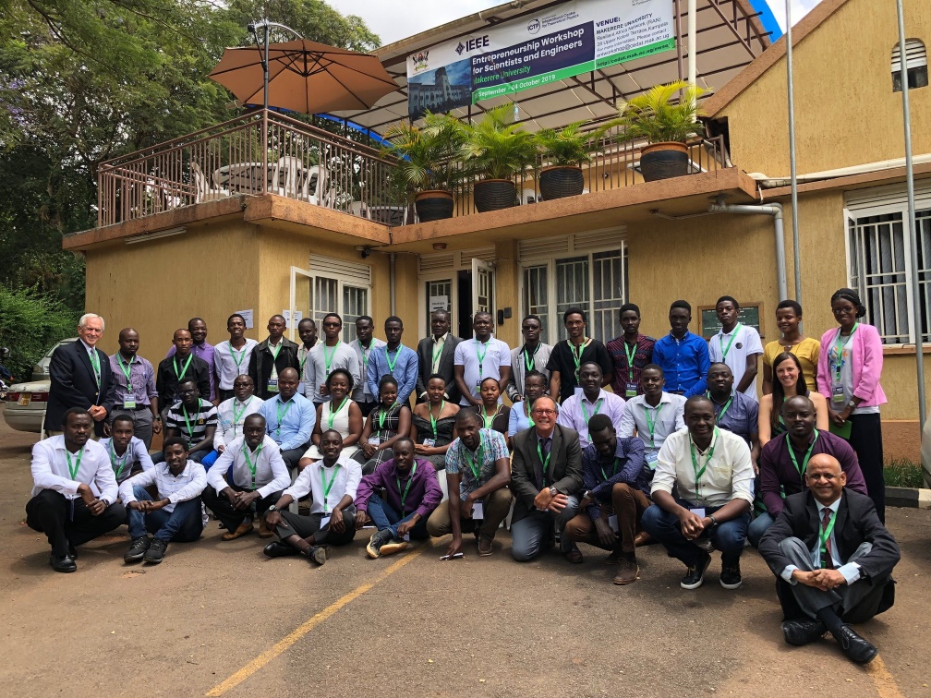
IEEE Entrepreneurship Mentors / Workshops
The Personal Touch
  Founders Office Hours -- mentoring by entrepreneurial leaders and investors
  IEEE Entrepreneurship Workshops for Engineers and Scientists & Innovation Nation

Slide 23


IEEE Entrepreneurship Career Center
& Global Accelerator Startup Index
  The Global Startup Accelerator Index is an IEEE information resource for researching entrepreneurship that includes universities, co-working spaces, pitch competitions, incubators, accelerators, grants, and funding.
  The IEEE Entrepreneurship Career Center bridges the gap between job seekers and employers in the engineering-driven startup community. It provides many useful resources for recruiters, job seekers, and employers.

Slide 24
2020 IEEE Entrepreneurship Supported Events
IEEE Conferences and Events
Region 3 Directors
Region 4 Directors
Young Professionals Webinar
Melecon 2020
6th World Forum on IoT
5G World Forum
Quantum Week
World Congress on Computational Intelligence
IEEE Entrepreneurship External Collaborations
CES 2020 – IEEE Entrepreneurship Stars
IST Africa
IEEE / Activate Panel Discussion
G-STIC Global Video Pitch Competition
PowerAfrica2020 Tutorial
Vaughn Summer Academy
Women in Engineering International Leadership Summit- Kampala, Uganda
R8 Young Professionals Entrepreneurship Competition
UN-ITU Digital-Change-Maker & Women-in-Tech Challenges

Slide 25
IEEE Entrepreneurship
How you can join us

Slide 26

IEEE Entrepreneurship
Join us for free !!!!
Social Media
  Web Site entrepreneurship.ieee.org
  Collabratec ( ~16K)
  Newsletter (~17K)
  IEEEtv Video views (~27K )
If you let us know about your entrepreneurial event, we will promote it!

Slide 27

Asante! Questions?
“Ukitaka kwenda kasi,
nenda peke yako.
Ukitaka kwenda mbali,
nendeni pamoja”
“If you want to go fast,
go alone.
If you want to go far,
go together.”
–African Saying
Photo by
Dale
Ressler

